Slide 1
BDS232 PYTHON PROGRAMMING UNIT II
Dr. Preethi.N

Slide 2
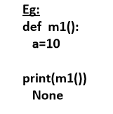
None Data Type:
None means Nothing or No value associated.
If the value is not available, then to handle such type of cases None introduced.

Slide 3
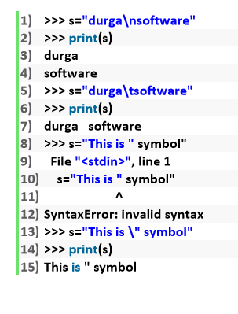
Escape Characters:
In String literals we can use escape characters to associate a special meaning.

Slide 4
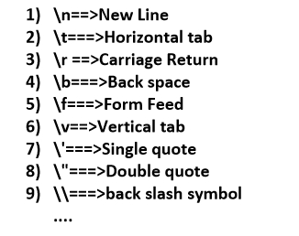
The following are various important escape characters in Python

Slide 5
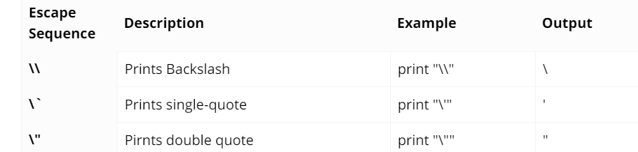
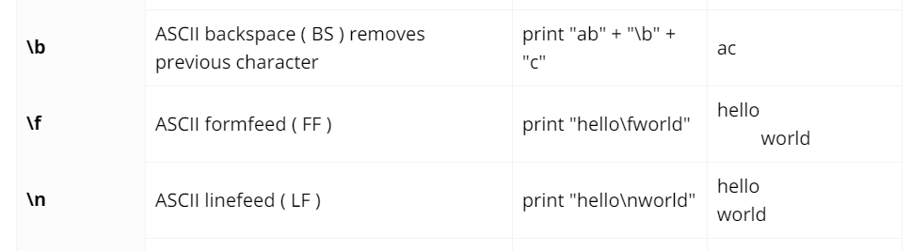
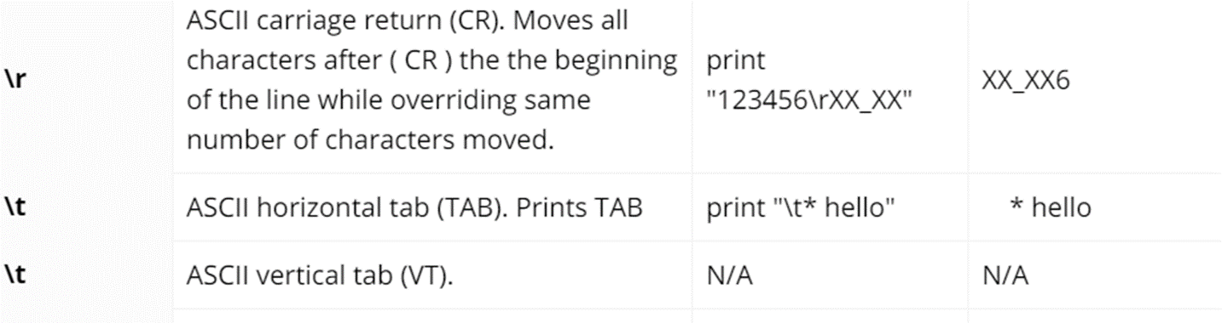

Slide 6

Constants:
Constants concept is not applicable in Python.
But it is convention to use only uppercase characters if we don’t want to change value.

Slide 7
Operators
Operator is a symbol that performs certain operations. Python provides the following set of operators
1. Arithmetic Operators
2. Relational Operators or Comparison Operators
3. Logical operators
4. Bitwise operators
5. Assignment operators
6. Special operators

Slide 8
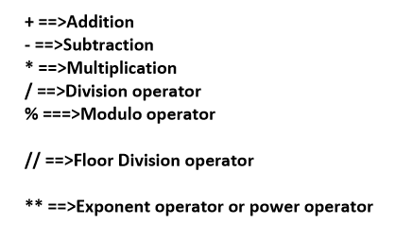
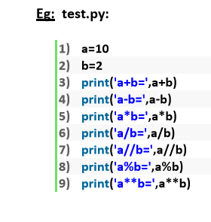
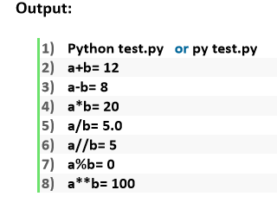
1. Arithmetic Operators:

Slide 9
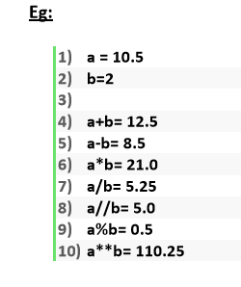
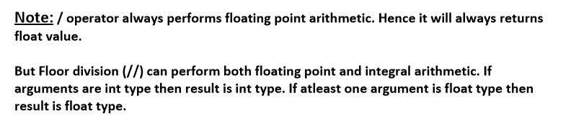
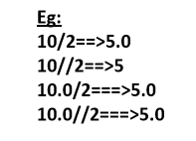

Slide 10
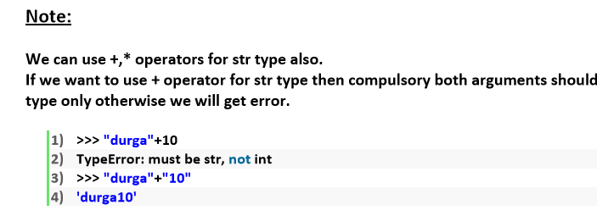

Slide 11
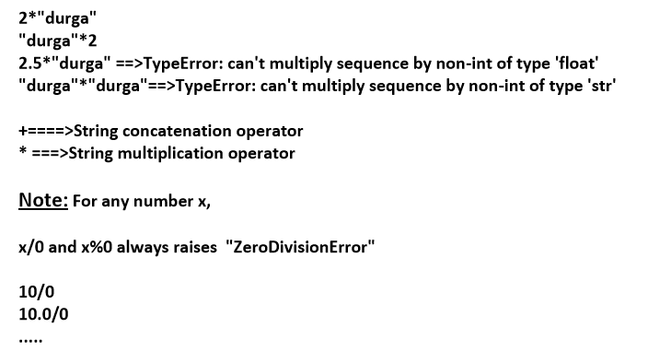
If we use * operator for str type then compulsory one argument should be int and other argument should be str type.

Slide 12
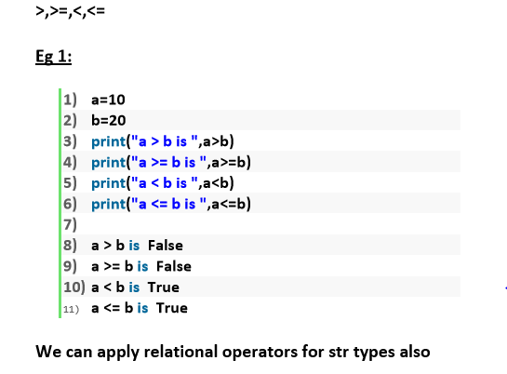
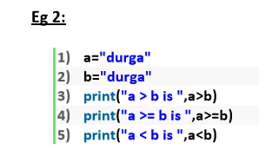
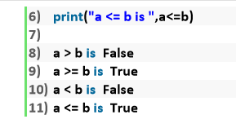
Relational Operators:

Slide 13
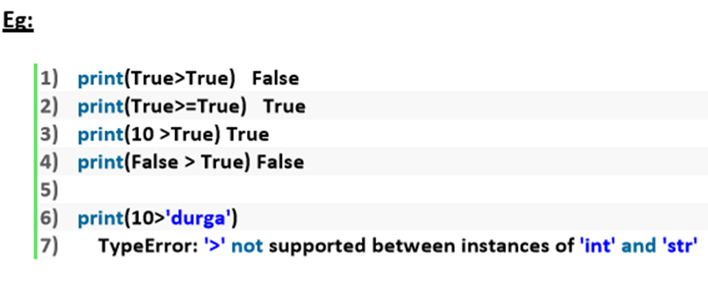
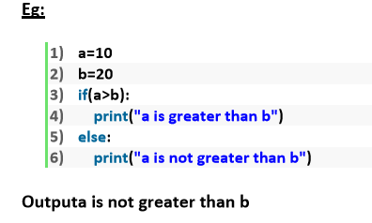
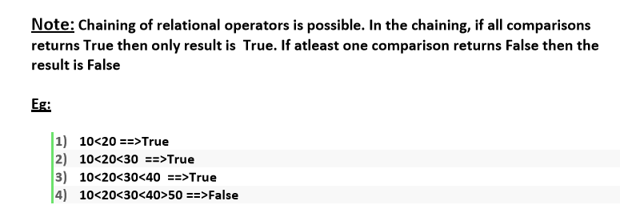

Slide 14

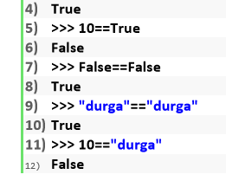
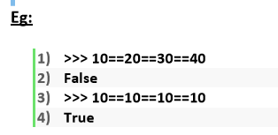
Equality operators:
== , !=
We can apply these operators for any type even for incompatible types also
Note: Chaining concept is applicable for equality operators. If atleast one comparison returns False then the result is False. otherwise the result is True.

Slide 15
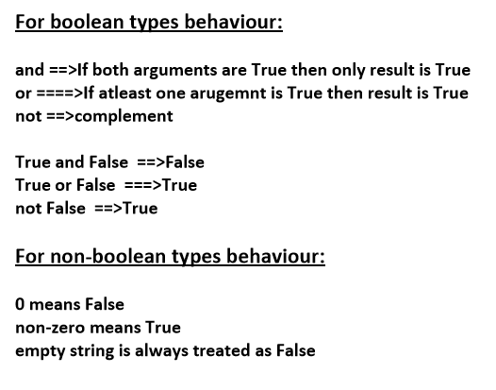
Logical Operators:
and, or ,not
We can apply for all types.

Slide 16

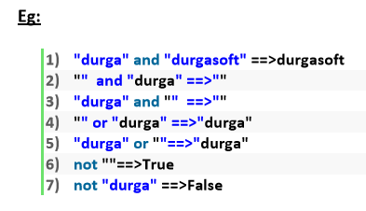
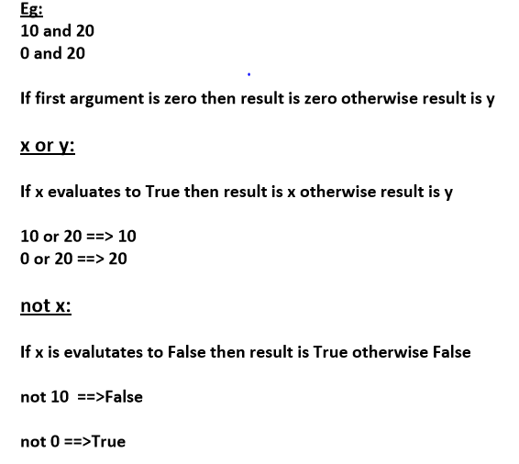

Slide 17
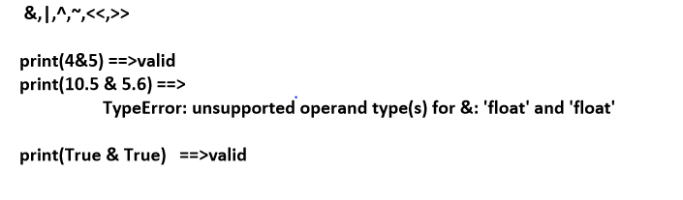
Bitwise Operators:
We can apply these operators bitwise.
These operators are applicable only for int and boolean types.
By mistake if we are trying to apply for any other type then we will get Error.

Slide 18
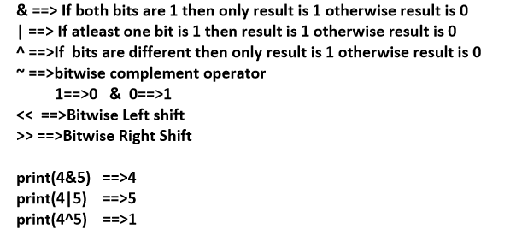
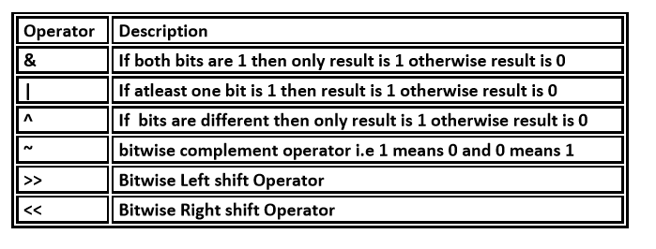

Slide 19
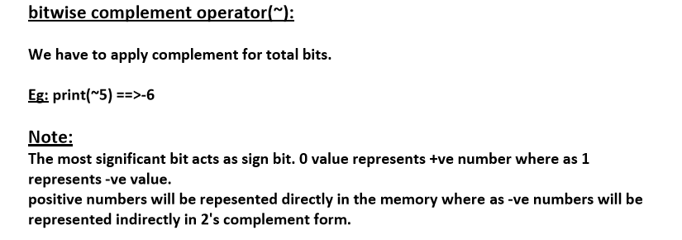

Slide 20
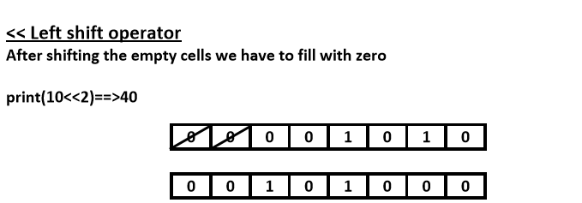
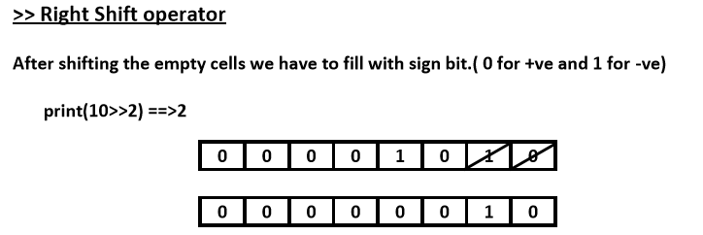
Shift Operators:

Slide 21
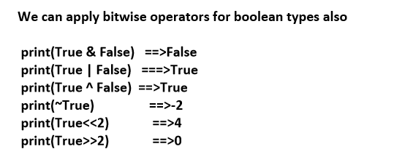

Slide 22
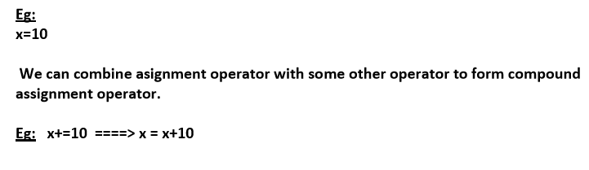
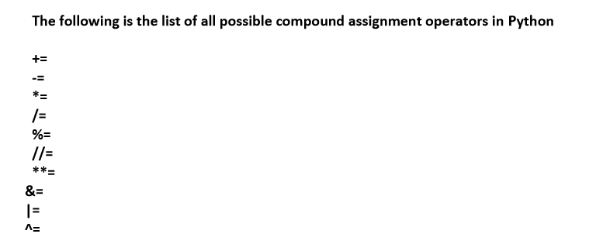
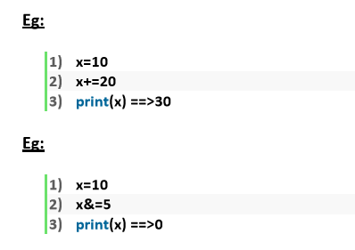

Assignment Operators:
We can use assignment operator to assign value to the variable.

Slide 23
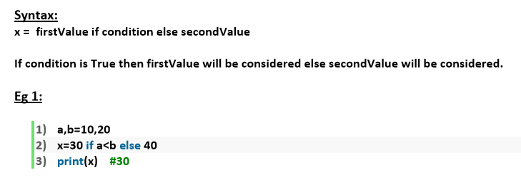
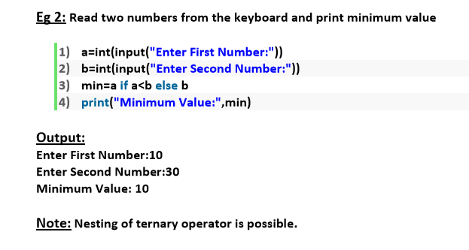
Ternary Operator:

Slide 24
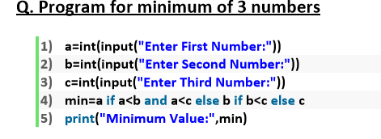
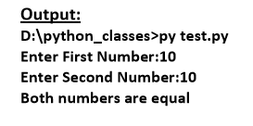
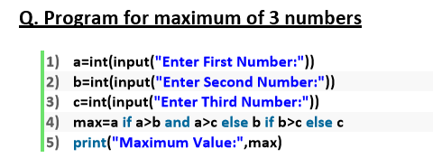
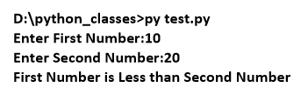

Slide 25
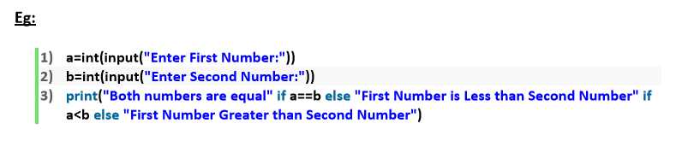
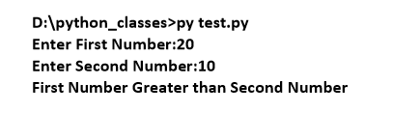

Slide 26
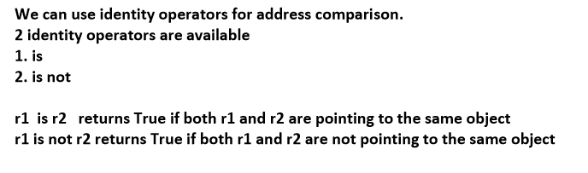
Special operators:
Python defines the following 2 special operators
1. Identity Operators
2. Membership operators

Slide 27
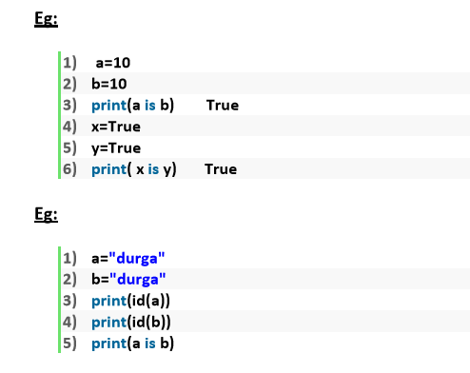
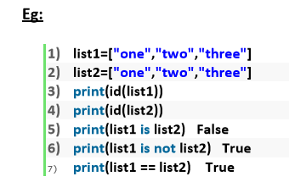


Slide 28
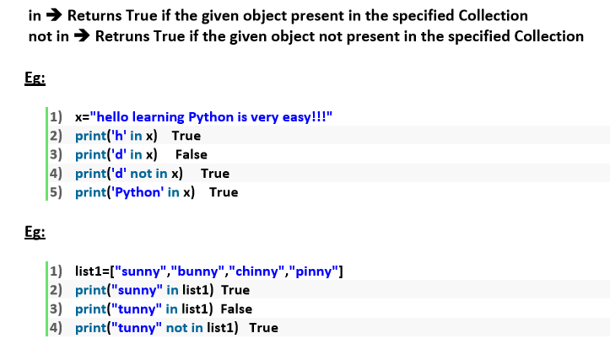
2. Membership operators:
We can use Membership operators to check whether the given object present in the given collection.(It may be String, List, Set, Tuple or Dict)

Slide 29
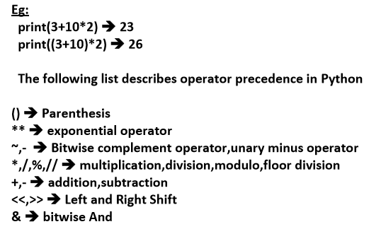
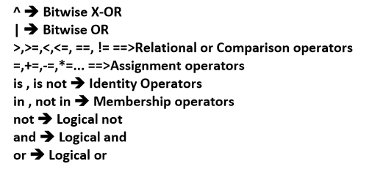
Operator Precedence:
If multiple operators present then which operator will be evaluated first is decided by operator precedence.

Slide 30
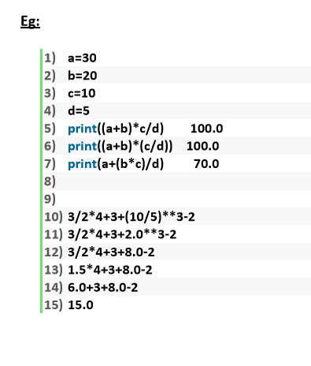

Slide 31
Flow Control

Slide 32

Flow Control

Slide 33



Slide 34


Slide 35



Slide 36


Slide 37



Slide 38


Slide 39


Slide 40
II -Iterative Statements

Slide 41
Iterative Statements
If we want to execute a group of statements multiple times then we should go for Iterative statements.
Python supports 2 types of iterative statements.
1. for loop
2. while loop

Slide 42



Slide 43



Slide 44


Slide 45


Slide 46


Slide 47


Slide 48



Slide 49
III Transfer Statements

Slide 50



Slide 51



Slide 52



Slide 53




Slide 54


Slide 55


Slide 56



Slide 57



Slide 58


